Slide 1
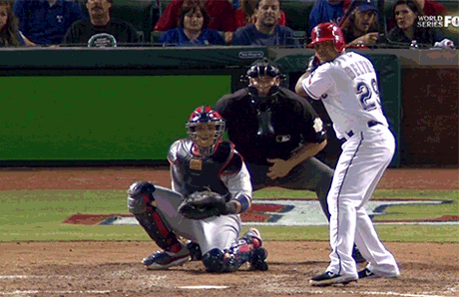
Superstar players based on their salaries
Project 1: Calvin Cusick,
Ebrahim Moosa, Nicklaus Austin, Diana Andrade

Slide 2
Overview
Overview Data Set
Inspiration
Research questions
Our Analysis
Our Conclusions

Slide 3

Data Overview
Our data resources came from Kaggle which we gathered different CVS file paths to determine different questions that we can possibly come to conclusions to our questions.
Focused on data from 2000 to 2016
Finalized cvs paths that contained sufficient data to determine our hypothesis
Cleaned data set and analyze outliners

Slide 4
Inspiration
Looking into a sport profession and analyzing data from superstar players to understand how their salary is based upon their stats/ athletic ethic etc.
The below article is data from all mlb superstar players as of 2017 where we can create conclusions on particular interest to base our own conclusions through out a period of years.
MLB Superstar Power Rankings: How Each Team's Biggest Star Stacks Up | Bleacher Report | Latest News, Videos and Highlights

Slide 5
Research questions
Does pay “superstars” affect the pay of non-players?
Does it cause pay to increase over time?
Does winning % increase with team player value (sum of players value)?
How much do “superstar” players affect team play? If they are out of action, does win % go down?

Slide 6
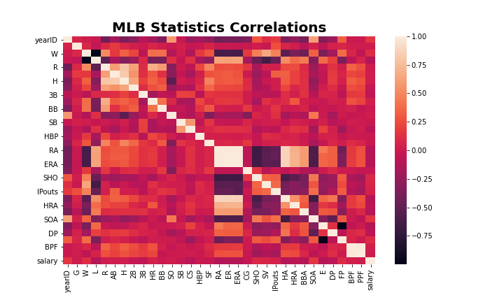
Heat Correlation

Slide 7
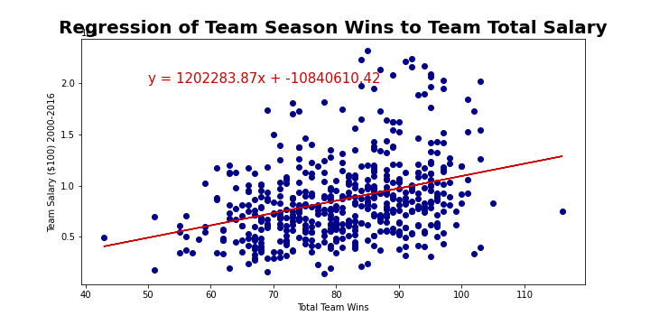
Regression

Slide 8
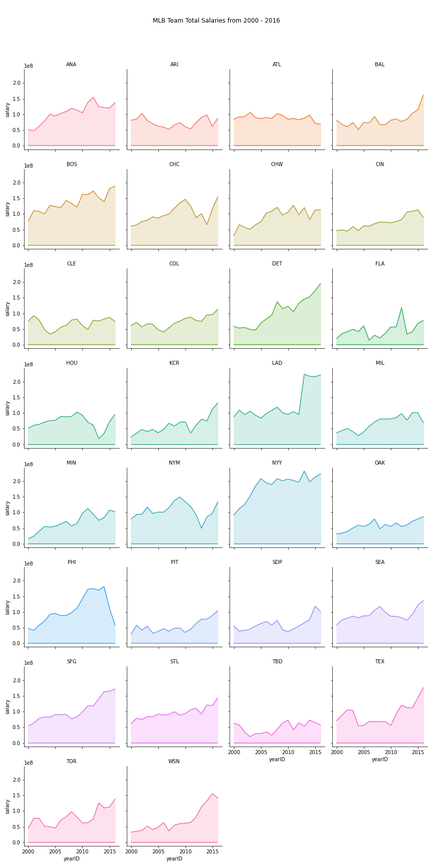
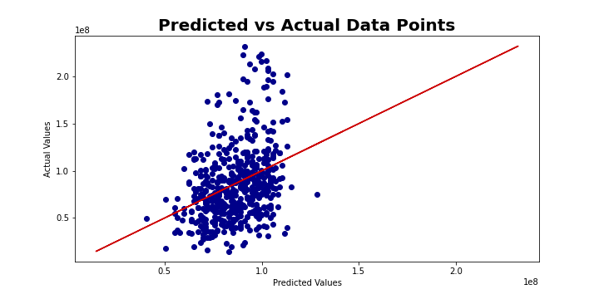
Predictions

Slide 9
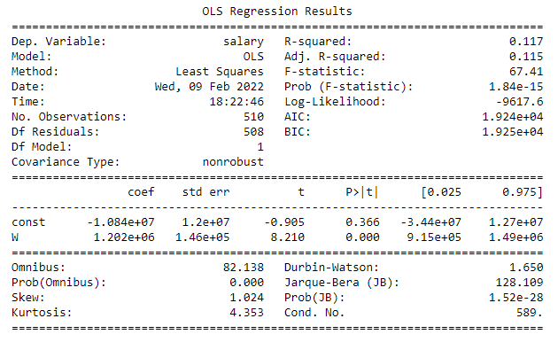
Regression Result

Slide 10
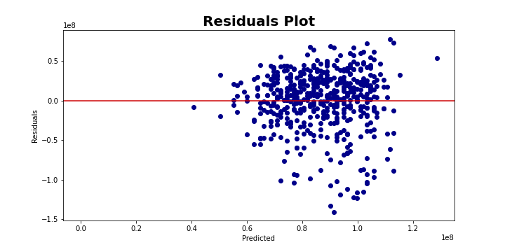
Plot

Slide 11
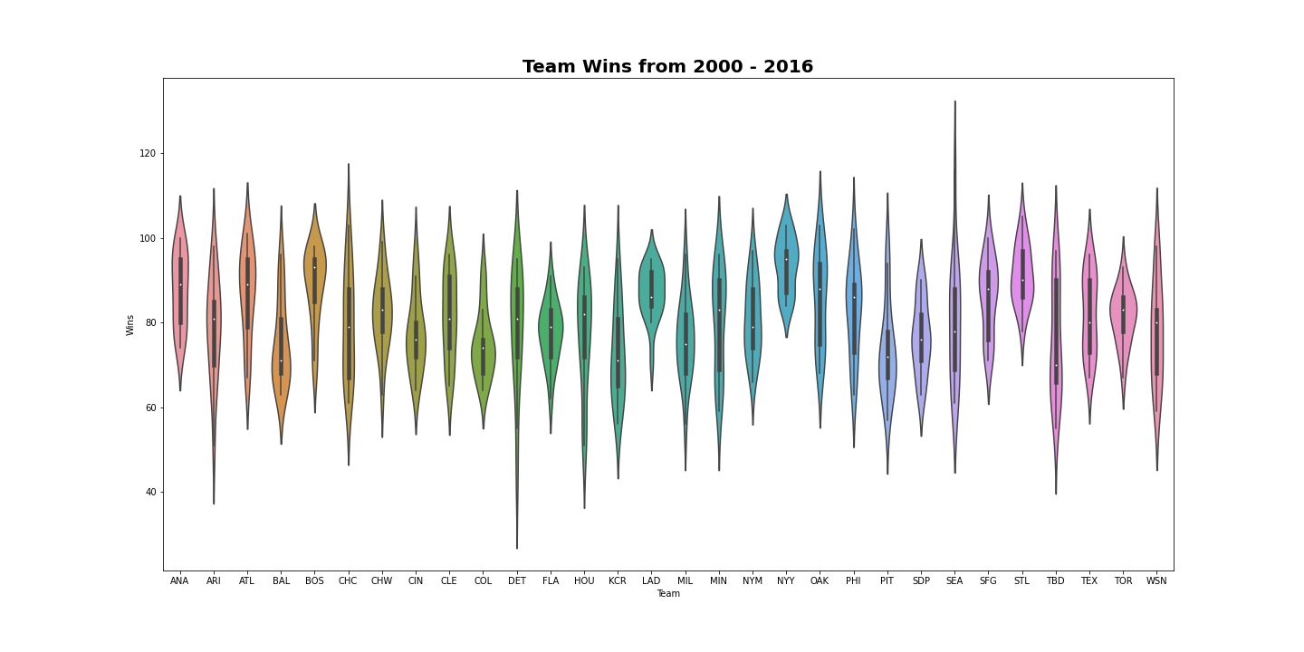
Teams Wins

